Slide 1
Introduction to Modern Software Development
Notes:
This module examines SharePoint Online development strategies and discusses the evolution of modern pages and Microsoft Teams into the SharePoint user experience. Students will learn to program using the Client-side Object Model (CSOM) using C# to automate remote provisioning tasks such as creating SharePoint sites and customized lists. Next, the module provides an overview of Microsoft Azure as a cloud-based development platform and demonstrates how to create essential on-demand services such as Azure Web Apps and Azure SQL databases. The module concludes with a TypeScript primer where students will learn to develop with TypeScript in Visual Studio 2017 to write client-side code using interfaces and strongly-typed programming.

Slide 2
Student Introductions
Basic Info
What’s your name?
Where do you work? (optional)
How long have you been a developer?
List skills with which you already feel comfortable
.NET programming with C# or VB.NET
SharePoint farm solution development
JavaScript, jQuery and Angular
Programming with REST and OData
Developing with ASP.NET MVC and Web API
Developing with AngularJS using version 1.0, 1.5 or 2.0

Slide 3
Agenda
Understanding SharePoint Development Strategies
Programming the Client-side Object Model (CSOM)
Understanding Azure as a Development Platform
Using Azure to create Web Apps and SQL Databases
Developing with TypeScript and Interfaces
Developing Client-side with Strongly-typed Programming

Slide 4
Cloud Computing 101
On-demand Service
Lessens/eliminates need for IT department to assist
Resource Pooling
Cloud-abstracted infrastructure
Rapid Elasticity
Scale up, Scale down, Scale out, Scale in
Measured Services
You pay for what you use
DevOps
Better coordination between developers and IT department

Slide 5
Cloud Computing Service Models
SaaS – Software as a service
Examples include Salesforce and Office 365
PaaS – Platform as a service
Examples include Azure Web Apps
DaaS – Database as a service
Examples include Azure SQL databases
IaaS – Infrastructure as a service
Examples include Azure VMs and cloud services

Slide 6
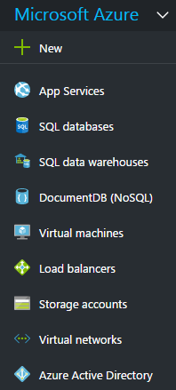
Azure Services Overview
Azure provides PaaS, DaaS and IaaS Services
App Service Plans and Web Apps
SQL databases
Virtual machines
Storage accounts
Virtual networks
Load balancers
Cloud Services
Azure Active Directory
Azure Functions
Notes:
20532C
1: Overview of the Microsoft Azure Platform

Slide 7
Azure Architecture: ASM vs. ARM
Azure Service Management
Used when you work with the Classic Azure Portal
XML-based REST API
VMs made accessible through Azure cloud services
Azure Resource Manager
Used when you work with the New Azure Portal
JSON-based REST API
Resources are JSON template-based containers
Replaces cloud services with virtual networks
Introduces Resource Groups as organizational containers
Introduces Role-based access control (RBAC)

Slide 8
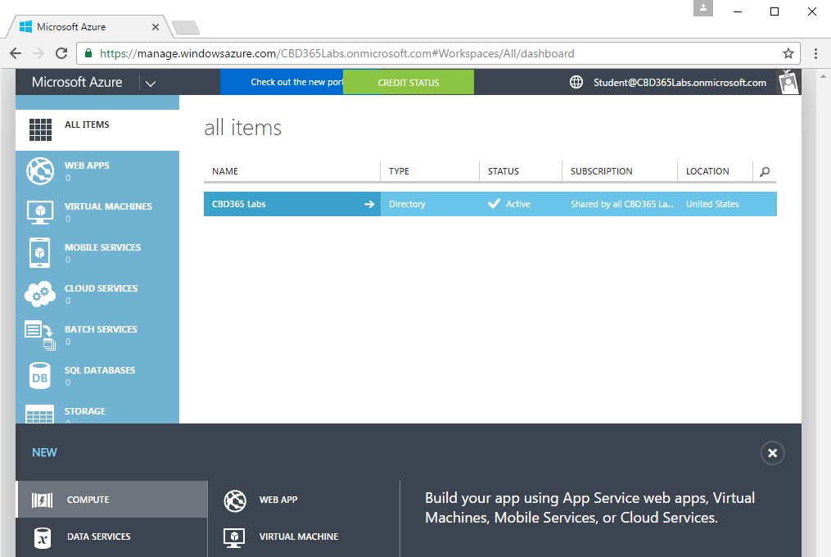
Classic Azure Portal
You can work with Azure using the classic portal
Uses older service management infrastructure
Located at https://manage.windowsazure.com
Notes:
20532C
1: Overview of the Microsoft Azure Platform

Slide 9
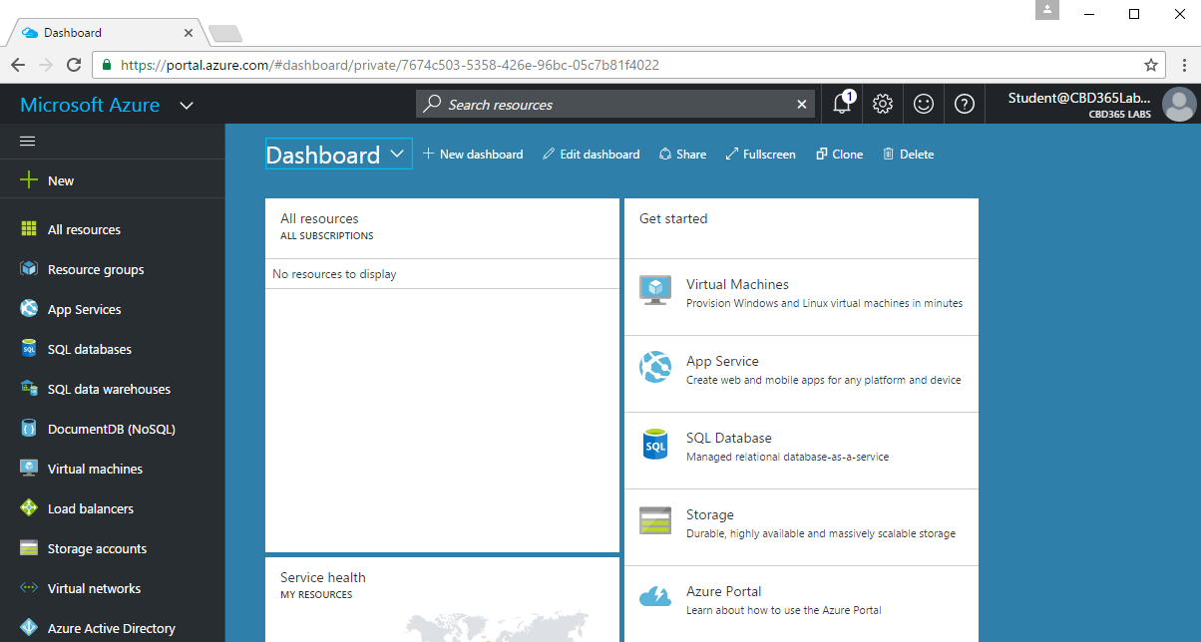
New Azure Portal
You can work with Azure using the new portal
Uses newer Resource Manager infrastructure
Located at https://portal.azure.com
Notes:
20532C
1: Overview of the Microsoft Azure Platform

Slide 10
Essential Azure Services for Developers
App Service Plans and Web Apps
Virtual Machines and Virtual Networks
Azure Storage Accounts
Azure SQL Databases
Azure Active Directory

Slide 11
Agenda
Microsoft Azure Platform Overview
Extending SharePoint Online
Developing with Azure Active Directory
Developing with the Visual Studio 2017
Developing with Node.JS & Visual Studio Code
Getting Started with Office 365 & Microsoft Azure

Slide 12
Evolution of the SharePoint Platform
Farm Solutions
Sandboxed Solutions
SharePoint Add-ins
JavaScript Injection
SharePoint Framework (SPFx)

Slide 13
SharePoint App Add-in Model
SharePoint 2013 introduced new development model
Originally introduced as "SharePoint App” model
Marketing folks renamed "SharePoint App” to "SharePoint Add-in”
Add-in model designed to replace farm solutions
Add-ins designed to supported SPO and SharePoint on-premises
Add-in code not allowed to run on SharePoint host server
Add-in talks to SharePoint using REST and CSOM
Add-in authenticates and establishes add-in identity
Add-in has permissions independent of user
Add-ins deployed to catalogs using publishing scheme

Slide 14
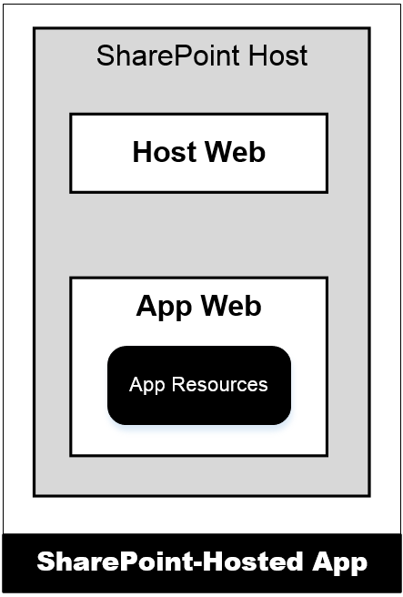
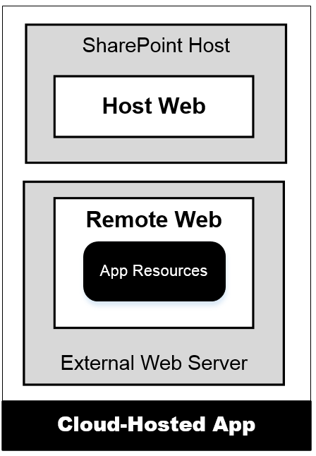
Hosting Options for SharePoint Add-ins
SharePoint-Hosted Add-ins
Add-in resources added to SharePoint host
Stored in child site known as app web
Add-in has only client-side code
Add-in cannot have server-side code
Provider-Hosted Add-ins
Add-in resources deployed on remote server
Remote site known as remote web
Add-in can have client-side code
Add-in can have server-side code
Notes:
There are two different types of apps and a few terms you should be aware of. First, apps are either hosted within SharePoint or they are hosted outside of SharePoint. The first type of app, a SharePoint-Hosted app is the type where all the app’s resources (pages, JavaScript, style sheets and images) are all provisioned to the SharePoint host. The business logic within SharePoint-Hosted apps runs within the client (browser). The hosting model for a Provider-hosted app is quite different in the sense that the bulk of the app logic and maintainable reside outside of SharePoint, for instance as an ASP.NET MVC site on another Windows Server, in Azure, as a PHP site in Amazon Web Services or any number of other options.
The site in which an app is installed form is called the host web. When an app with SharePoint-hosted resources is installed, the SharePoint host will create a subsite known as the app web. For provider-hosted apps, the remote site is known as the remote web.

Slide 15
APIs used by SharePoint Add-ins
SharePoint REST API
Commonly used with client-side JavaScript code
Good fit when developing SharePoint-hosted add-ins
Accessible to any type of client on any platform
Client-side Object Model (CSOM)
Commonly used with server-side C# code
Good fit when developing provider-hosted add-ins
Good fit when creating desktop clients (e.g. Console app)
Used to perform remote provisioning in SPO sites

Slide 16
JavaScript Injection
JavaScript injection based on central concept…
upload custom JavaScript code to SharePoint Online
execute code using identity and permissions of current user
Approaches for using JavaScript injection
Script Editor Web Part
Adding JavaScript code behind SharePoint site pages
Full-blown Visual Studio project development
Why create solution using JavaScript Injection?
Provides more flexibility than SharePoint add-in model
Poses fewer constraints than SharePoint add-in model

Slide 17
Remote Provisioning
Remote provisioning in SPO
Use CSOM to create SPO site elements
Recommended over SharePoint solutions & features
What can you create with Remote Provisioning
New child sites, lists and document libraries
Site columns, content types and remote event receivers
New pages with custom JavaScript logic
User custom actions with custom JavaScript logic

Slide 18
The SharePoint Framework (SPFx)
Development model based on pages and web parts
Based on client-side development with JavaScript or TypeScript
Code runs with authenticated identity of current user
Easy access to SharePoint and Office 365 content and data
Developer tools designed to support cross-platform development
Great support for targeting mobile devices
SharePoint Page
Client-side Web Part 1
Client-side Web Part 2
JavaScript
TypeScript
Knockout
React
SharePoint REST API
Microsoft Graph API

Slide 19
Agenda
Microsoft Azure Platform Overview
Extending SharePoint Online
Developing with Azure Active Directory
Developing with the Visual Studio 2017
Developing with Node.JS & Visual Studio Code
Getting Started with Office 365 & Microsoft Azure

Slide 20
Azure Active Directory and Office 365
Office 365 environments are based on Azure AD tenants
Tenant provides scope for creating and managing users
Office 365 is integrated with Azure Active Directory (AAD)
Each Office 365 organization is backed by an AAD tenant
AAD tenant can be managed using Office 365 administration
AAD tenant can be managed using Windows Azure Portal
AAD tenant can be managed using Windows PowerShell
Azure support registering application within scope of AAD tenant

Slide 21
Agenda
Microsoft Azure Platform Overview
Extending SharePoint Online
Developing with Azure Active Directory
Developing with the Visual Studio 2017
Developing with Node.JS & Visual Studio Code
Getting Started with Office 365 & Microsoft Azure

Slide 22
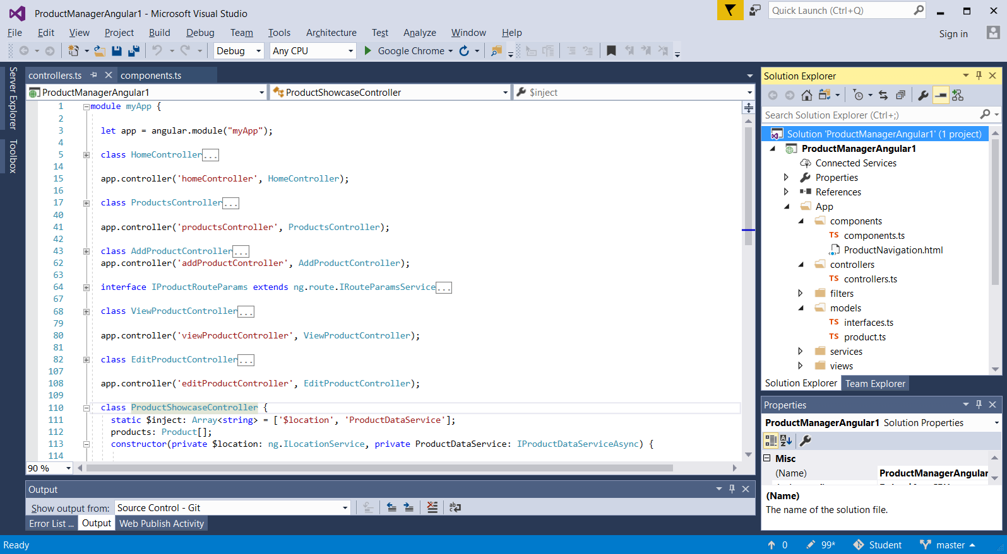
Developing with Visual Studio 2017

Slide 23
Agenda
Microsoft Azure Platform Overview
Extending SharePoint Online
Developing with Azure Active Directory
Developing with the Visual Studio 2017
Developing with Node.JS & Visual Studio Code
Getting Started with Office 365 & Microsoft Azure

Slide 24
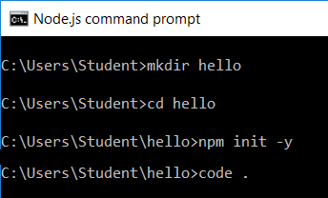
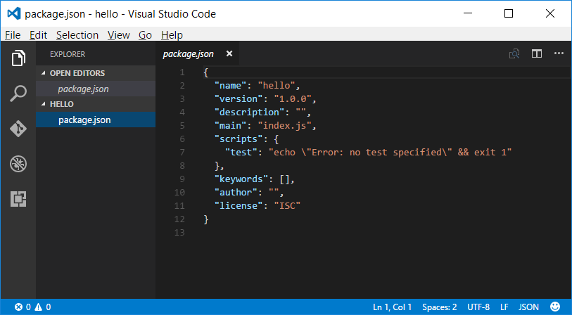
Developing with NPM & Visual Studio Code

Slide 25
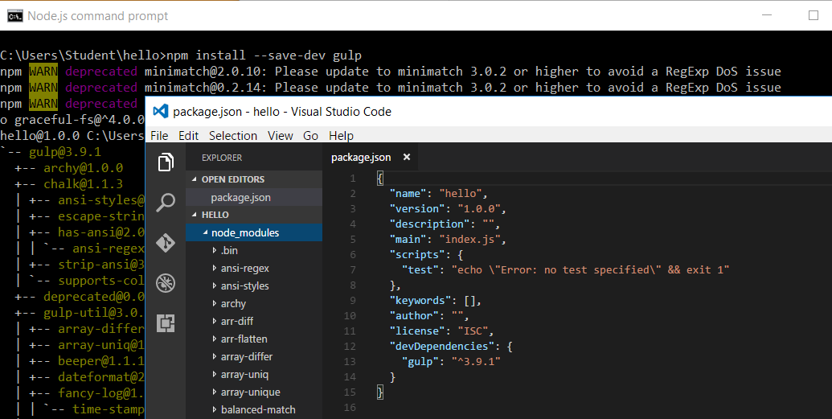
Adding NPM Packages

Slide 26
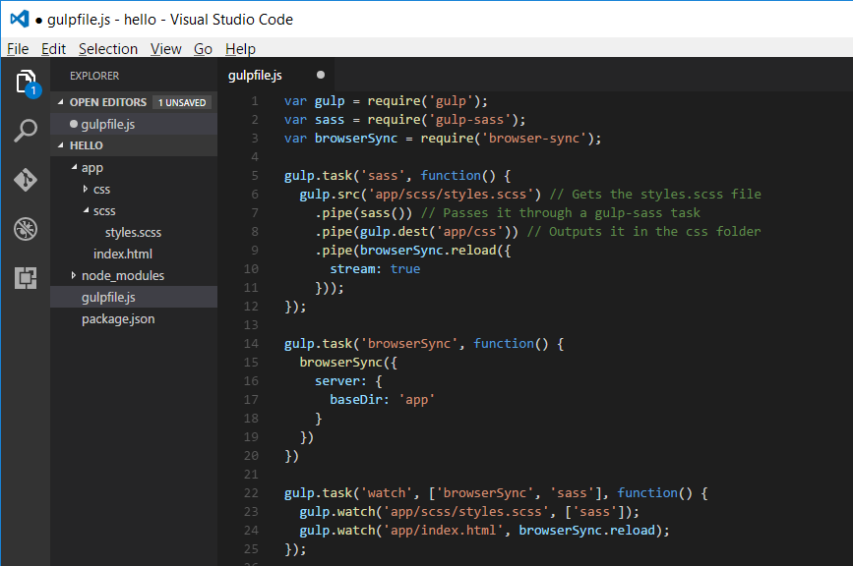
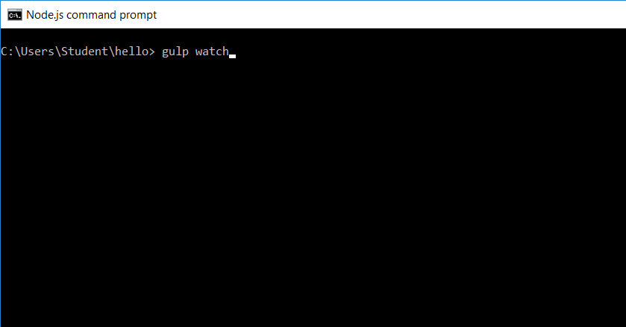
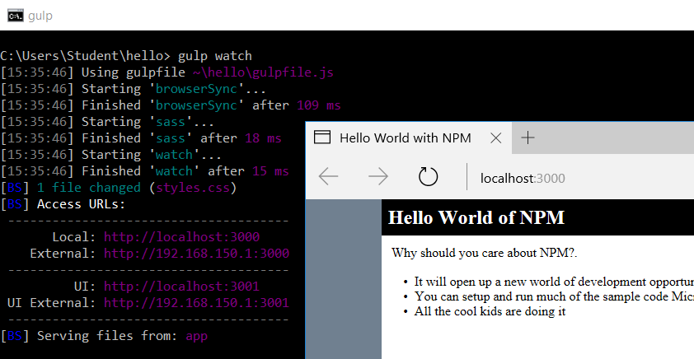
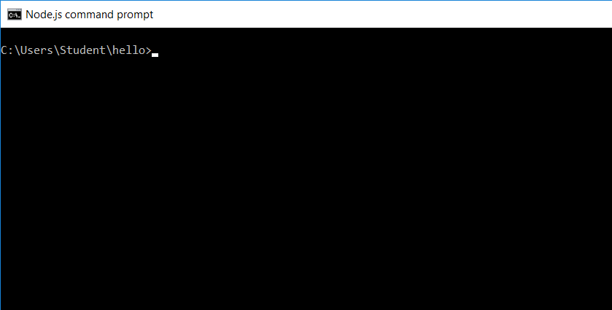
Developing with Gulp Tasks

Slide 27
Agenda
Microsoft Azure Platform Overview
Extending SharePoint Online
Developing with Azure Active Directory
Developing with the Visual Studio 2017
Developing with Node.JS & Visual Studio Code
Getting Started with Office 365 & Microsoft Azure

Slide 28
Getting Started with Cloud Development
Obtain an Office 365 developer account
Create an Office 365 Developer Site
Obtain a Windows Azure subscription
Develop solutions remotely with Visual Studio
Getting around inside your Office 365 Tenancy
Office 365 administrative tools
SharePoint administrative tools
Azure Management Portal
PowerShell utilities

Slide 29
Office 365 Tenancies in SharePoint Online
Office 365 environment based on tenancies
New tenancy is created for each customer organization
Tenancy provides scope for creating users and groups
Tenancy provides scope for creating SharePoint sites
Tenancy provides scope for SharePoint add-ins
Office 365 Developer should be tenant admin
Provides permissions you need to develop and test

Slide 30
Obtaining an Azure Subscription
Getting an Azure Subscription
Sign up with paid-for account
Get free Azure subscription with a MSDN Subscription
Sign up for free 30-day trial account
Signing up for free trial account
Navigate to Azure Portal using Office 365 credentials
When prompted, sign up for a trial

Slide 31
Getting Around inside the Azure Portal
https://portal.azure.com
Notes:
20532C
1: Overview of the Microsoft Azure Platform

Slide 32
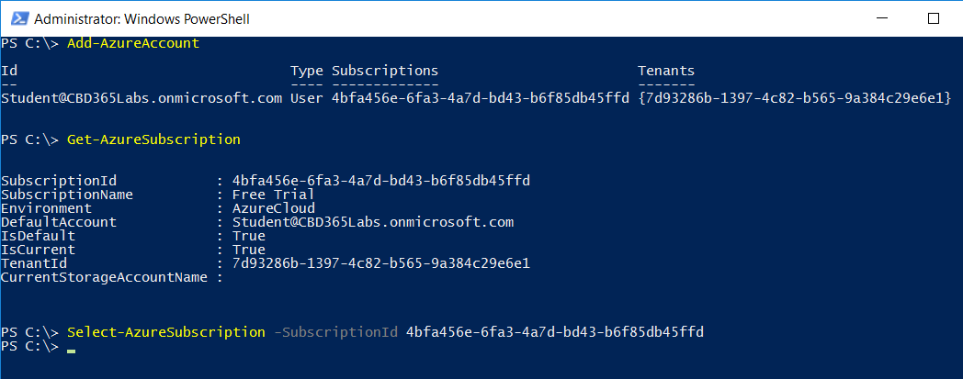
PowerShell with Service Management

Slide 33
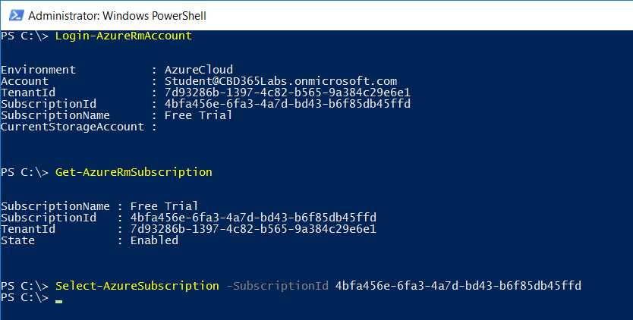
PowerShell with Resource Manager

Slide 34
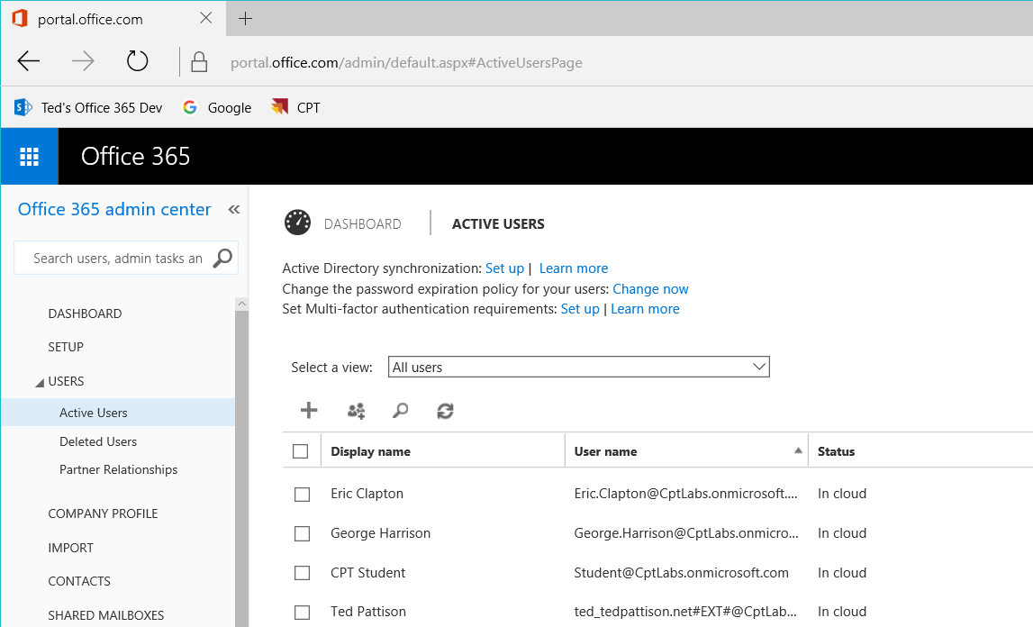
Office 365 admin center

Slide 35
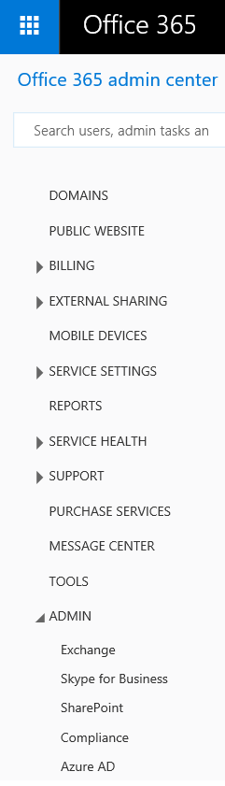
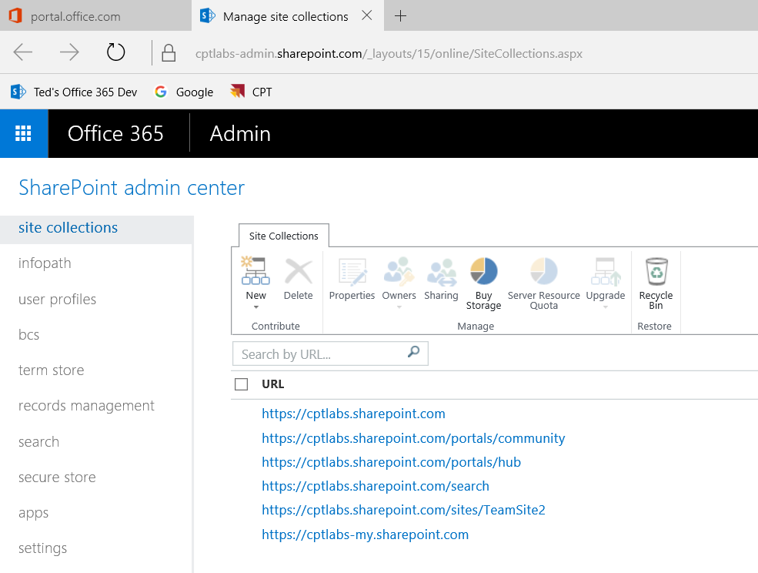
SharePoint admin center

Slide 36
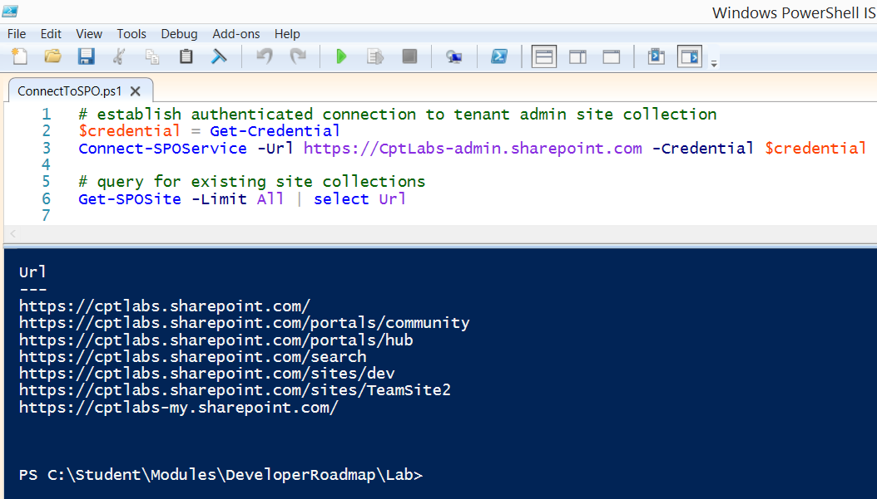
SharePoint Online Management Shell

Slide 37
Summary
Microsoft Azure Platform Overview
Extending SharePoint Online
Developing with Azure Active Directory
Developing with the Visual Studio 2017
Developing with Node.JS & Visual Studio Code
Getting Started with Office 365 & Microsoft Azure

